Slide 1
Getting started with neural networks
Dr. Noman Islam

Slide 2
Agenda
We’ll dive into three introductory examples of how to use neural networks to address real problems:
Classifying movie reviews as positive or negative (binary classification)
Classifying news wires by topic (multiclass classification)
Estimating the price of a house, given real-estate data (regression)

Slide 3
Anatomy of a neural network
As you saw in the previous chapters, training a neural network revolves around the following objects:
Layers, which are combined into a network (or model)
The input data and corresponding targets ○ The loss function, which defines the feedback signal used for learning
The optimizer, which determines how learning proceeds

Slide 4
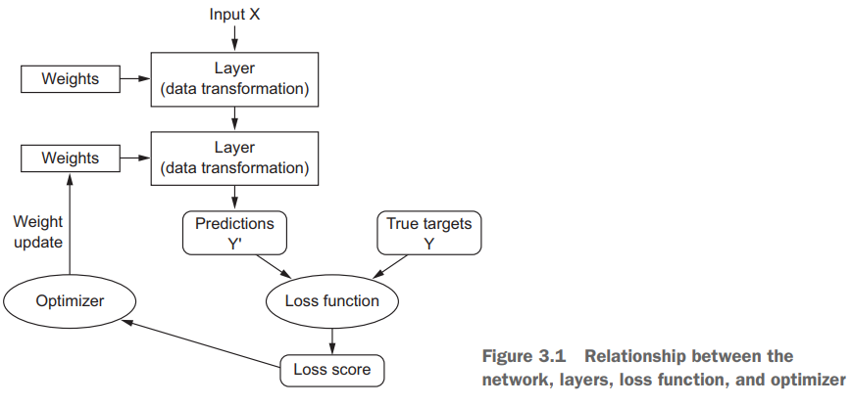

Slide 5
The network, composed of layers that are chained together, maps the input data to predictions.
The loss function then compares these predictions to the targets, producing a loss value: a measure of how well the network’s predictions match what was expected.
The optimizer uses this loss value to update the network’s weights.

Slide 6
Layers: the building blocks of deep learning
The fundamental data structure in neural networks is the layer
A layer is a data-processing module that takes as input one or more tensors and that outputs one or more tensors.
Some layers are stateless, but more frequently layers have a state: the layer’s weights, one or several tensors learned with stochastic gradient descent, which together contain the network’s knowledge.

Slide 7
Layers perform tensor operations
Different layers are appropriate for different tensor formats and different types of data processing.
For instance, simple vector data, stored in 2D tensors of shape (samples, features), is often processed by densely connected layers, also called fully connected or dense layers (the Dense class in Keras).
Sequence data, stored in 3D tensors of shape (samples, timesteps, features), is typically processed by recurrent layers such as an LSTM layer.
Image data, stored in 4D tensors, is usually processed by 2D convolution layers (Conv2D).

Slide 8
Layers are like LEGO blocks
You can think of layers as the LEGO bricks of deep learning, a metaphor that is made explicit by frameworks like Keras.
Building deep-learning models in Keras is done by clipping together compatible layers to form useful data-transformation pipelines.
The notion of layer compatibility here refers specifically to the fact that every layer will only accept input tensors of a certain shape and will return output tensors of a certain shape

Slide 9
Layers compatibility
When using Keras, you don’t have to worry about compatibility, because the layers you add to your models are dynamically built to match the shape of the incoming layer.

Slide 10
Models: networks of layers
A deep-learning model is a directed, acyclic graph of layers.
The most common instance is a linear stack of layers, mapping a single input to a single output
But as you move forward, you’ll be exposed to a much broader variety of network topologies. Some common ones include the following:
Two-branch networks
Multihead networks
Inception blocks

Slide 11
Hypothesis space
The topology of a network defines a hypothesis space
We defined machine learning as “searching for useful representations of some input data, within a predefined space of possibilities, using guidance from a feedback signal.”
By choosing a network topology, you constrain your space of possibilities (hypothesis space) to a specific series of tensor operations, mapping input data to output data.
What you’ll then be searching for is a good set of values for the weight tensors involved in these tensor operations.

Slide 12
Loss functions and optimizers: keys to configuring the learning process
Once the network architecture is defined, you still have to choose two more things:
Loss function (objective function)—The quantity that will be minimized during training. It represents a measure of success for the task at hand.
Optimizer—Determines how the network will be updated based on the loss function. It implements a specific variant of stochastic gradient descent (SGD).

Slide 13
A neural network that has multiple outputs may have multiple loss functions (one per output).
But the gradient-descent process must be based on a single scalar loss value; so, for multiloss networks, all losses are combined (via averaging) into a single scalar quantity

Slide 14
Choosing the right objective function for the right problem is extremely important: your network will take any shortcut it can, to minimize the loss; so if the objective doesn’t fully correlate with success for the task at hand, your network will end up doing things you may not have wanted
Fortunately, when it comes to common problems such as classification, regression, and sequence prediction, there are simple guidelines you can follow to choose the correct loss.

Slide 15
Loss function for different problems
For instance, you’ll use binary crossentropy for a two-class classification problem, categorical crossentropy for a many-class classification problem, meansquared error for a regression problem, connectionist temporal classification (CTC) for a sequence-learning problem, and so on.
Only when you’re working on truly new research problems will you have to develop your own objective functions.

Slide 16
Introduction to Keras
Keras is a deep-learning framework for Python that provides a convenient way to define and train almost any kind of deep-learning model.
Keras was initially developed for researchers, with the aim of enabling fast experimentation.
It allows the same code to run seamlessly on CPU or GPU.
It has a user-friendly API that makes it easy to quickly prototype deep-learning models

Slide 17
It has built-in support for convolutional networks (for computer vision), recurrent networks (for sequence processing), and any combination of both.
It supports arbitrary network architectures: multi-input or multi-output models, layer sharing, model sharing, and so on.
This means Keras is appropriate for building essentially any deep-learning model, from a generative adversarial network to a neural Turing machine.

Slide 18
Users of Keras
Keras has well over 200,000 users, ranging from academic researchers and engineers at both startups and large companies to graduate students and hobbyists.
Keras is used at Google, Netflix, Uber, CERN, Yelp, Square, and hundreds of startups working on a wide range of problems.
Keras is also a popular framework on Kaggle, the machine-learning competition website, where almost every recent deep-learning competition has been won using Keras models.

Slide 19
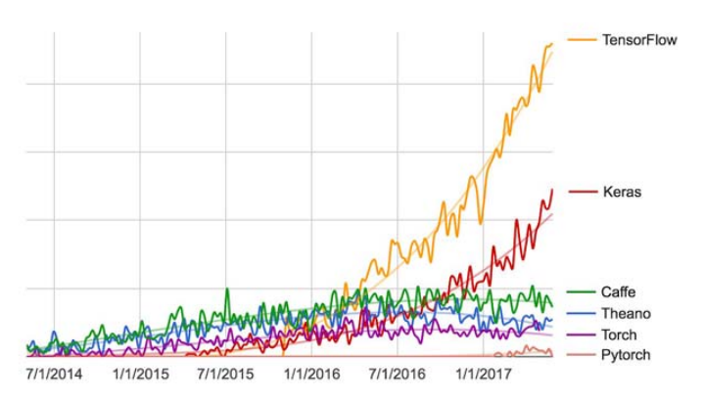

Slide 20
Keras, TensorFlow, Theano, and CNTK
Keras is a model-level library, providing high-level building blocks for developing deep-learning models.
It doesn’t handle low-level operations such as tensor manipulation and differentiation.
Instead, it relies on a specialized, well-optimized tensor library to do so, serving as the backend engine of Keras.
Rather than choosing a single tensor library and tying the implementation of Keras to that library, Keras handles the problem in a modular way (see figure 3.3); thus several different backend engines can be plugged seamlessly into Keras.

Slide 21
Currently, the three existing backend implementations are the TensorFlow backend, the Theano backend, and the Microsoft Cognitive Toolkit (CNTK) backend.
In the future, it’s likely that Keras will be extended to work with even more deep-learning execution engines.
TensorFlow, CNTK, and Theano are some of the primary platforms for deep learning today.
Theano (http://deeplearning.net/software/theano) is developed by the MILA lab at Université de Montréal, TensorFlow (www.tensorflow.org) is developed by Google, and CNTK (https://github.com/Microsoft/CNTK) is developed by Microsoft

Slide 22
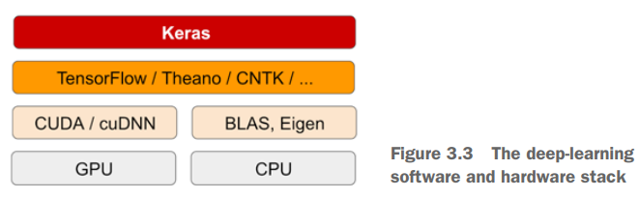

Slide 23
Via TensorFlow (or Theano, or CNTK), Keras is able to run seamlessly on both CPUs and GPUs.
When running on CPU, TensorFlow is itself wrapping a low-level library for tensor operations called Eigen (http://eigen.tuxfamily.org).
On GPU, TensorFlow wraps a library of well-optimized deep-learning operations called the NVIDIA CUDA Deep Neural Network library (cuDNN).

Slide 24
Developing with Keras: a quick overview
There are two ways to define a model: using the Sequential class (only for linear stacks of layers, which is the most common network architecture by far) or the functional API (for directed acyclic graphs of layers, which lets you build completely arbitrary architectures).

Slide 25
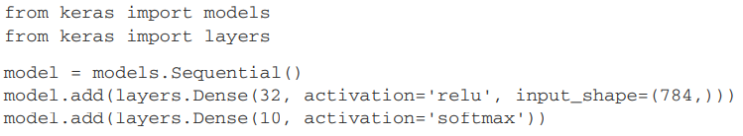
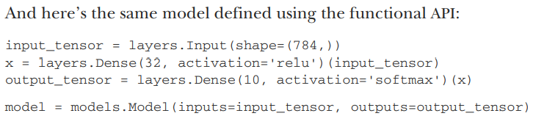

Slide 26
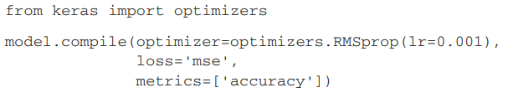

Slide 27
Setting up a deep-learning workstation
It’s highly recommended, although not strictly necessary, that you run deep-learning code on a modern NVIDIA GPU.
Some applications—in particular, image processing with convolutional networks and sequence processing with recurrent neural networks—will be excruciatingly slow on CPU, even a fast multicore CPU.
If you don’t want to install a GPU on your machine, you can alternatively consider running your experiments on an AWS EC2 GPU instance or on Google Cloud Platform

Slide 28
Jupyter notebook
Jupyter notebooks are a great way to run deep-learning experiments
A notebook is a file generated by the Jupyter Notebook app (https://jupyter.org), which you can edit in your browser
You can also run standalone Python scripts or run code from within an IDE such as PyCharm

Slide 29
Getting Keras running: two options
Use the official EC2 Deep Learning AMI (https://aws.amazon.com/amazonai/amis), and run Keras experiments as Jupyter notebooks on EC2. Do this if you don’t already have a GPU on your local machine.
Install everything from scratch on a local Unix workstation. You can then run either local Jupyter notebooks or a regular Python codebase. Do this if you already have a high-end NVIDIA GPU. Appendix A provides an Ubuntu-specific, step-by-step guide

Slide 30
Running deep-learning jobs in the cloud: pros and cons
If you’re using Jupyter notebooks, the experience of running in the cloud is no different from running locally.
As of mid-2017, the cloud offering that makes it easiest to get started with deep learning is definitely AWS EC2.
But if you’re a heavy user of deep learning, this setup isn’t sustainable in the long term—or even for more than a few weeks.
It costs $0.90 per hour as of mid-2017

Slide 31
Meanwhile, a solid consumerclass GPU will cost you somewhere between $1,000 and $1,500—a price that has been fairly stable over time, even as the specs of these GPUs keep improving.
If you’re serious about deep learning, you should set up a local workstation with one or more GPUs

Slide 32
What is the best GPU for deep learning?
The first thing to note is that it must be an NVIDIA GPU. NVIDIA is the only graphics computing company that has invested heavily in deep learning so far, and modern deep-learning frameworks can only run on NVIDIA cards.
As of mid-2017, we recommend the NVIDIA TITAN Xp as the best card on the market for deep learning.
For lower budgets, you may want to consider the GTX 1060

Slide 33
Classifying movie reviews: a binary classification example
You’ll work with the IMDB dataset: a set of 50,000 highly polarized reviews from the Internet Movie Database.
They’re split into 25,000 reviews for training and 25,000 reviews for testing, each set consisting of 50% negative and 50% positive reviews
Why use separate training and test sets? Because you should never test a machinelearning model on the same data that you used to train it!

Slide 34
Just because a model performs well on its training data doesn’t mean it will perform well on data it has never seen; and what you care about is your model’s performance on new data
Just because a model performs well on its training data doesn’t mean it will perform well on data it has never seen; and what you care about is your model’s performance on new data

Slide 35
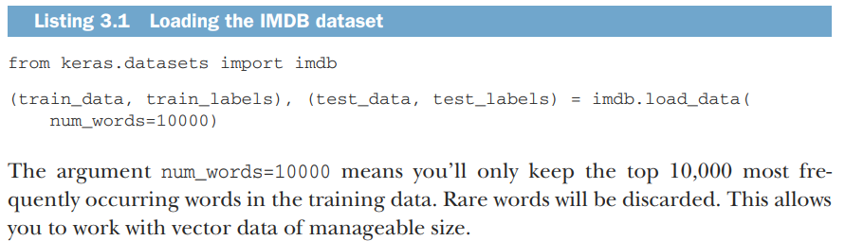

Slide 36
The variables train_data and test_data are lists of reviews; each review is a list of word indices (encoding a sequence of words). train_labels and test_labels are lists of 0s and 1s, where 0 stands for negative and 1 stands for positive:
> train_data[0]
Because you’re restricting yourself to the top 10,000 most frequent words, no word index will exceed 10,000:
>>> max([max(sequence) for sequence in train_data])

Slide 37
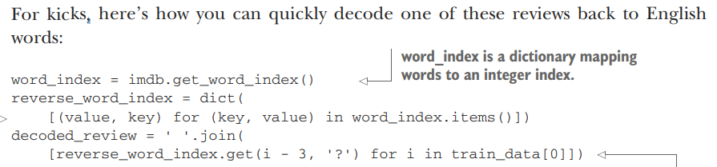

Slide 38
Preparing your data
You can’t feed lists of integers into a neural network. You have to turn your lists into tensors. There are two ways to do that:
Pad your lists so that they all have the same length, turn them into an integer tensor of shape (samples, word_indices), and then use as the first layer in your network a layer capable of handling such integer tensors (the Embedding layer, which we’ll cover in detail later in the book).

Slide 39
One-hot encode your lists to turn them into vectors of 0s and 1s. This would mean, for instance, turning the sequence [3, 5] into a 10,000-dimensional vector that would be all 0s except for indices 3 and 5, which would be 1s. Then you could use as the first layer in your network a Dense layer, capable of handling floating-point vector data.

Slide 40
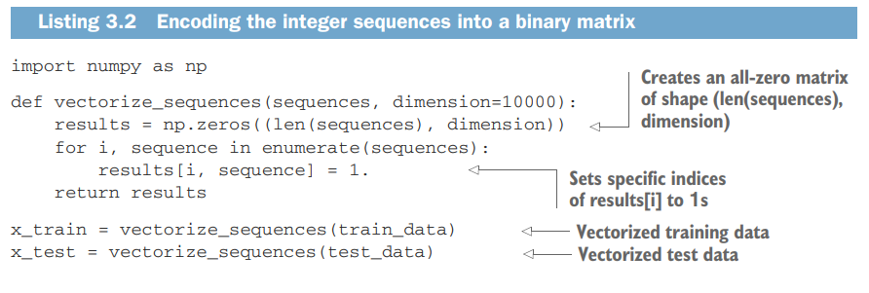

Slide 41
Building your network
The input data is vectors, and the labels are scalars (1s and 0s): this is the easiest setup you’ll ever encounter.
A type of network that performs well on such a problem is a simple stack of fully connected (Dense) layers with relu activations: Dense(16, activation='relu').
The argument being passed to each Dense layer (16) is the number of hidden units of the layer.
A hidden unit is a dimension in the representation space of the layer

Slide 42
output = relu(dot(W, input) + b)
Having 16 hidden units means the weight matrix W will have shape (input_dimension, 16): the dot product with W will project the input data onto a 16-dimensional representation space (and then you’ll add the bias vector b and apply the relu operation).

Slide 43
You can intuitively understand the dimensionality of your representation space as “how much freedom you’re allowing the network to have when learning internal representations.”
Having more hidden units (a higher-dimensional representation space) allows your network to learn more-complex representations, but it makes the network more computationally expensive and may lead to learning unwanted patterns

Slide 44
There are two key architecture decisions to be made about such a stack of Dense layers:
How many layers to use
How many hidden units to choose for each layer

Slide 45
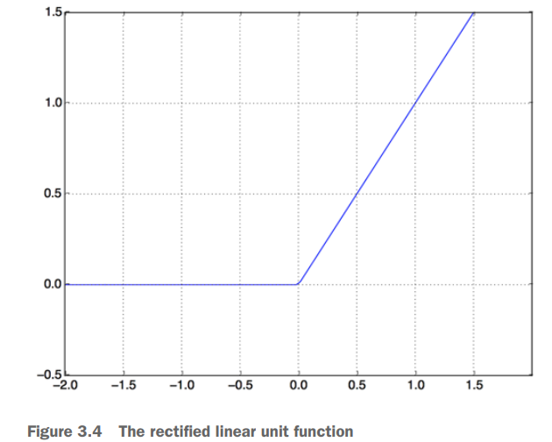

Slide 46
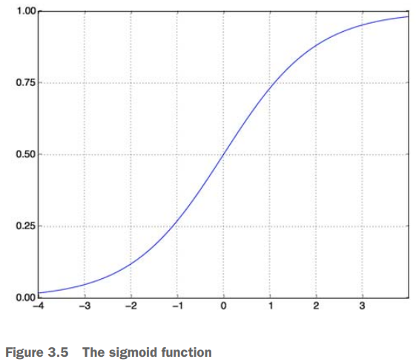

Slide 47
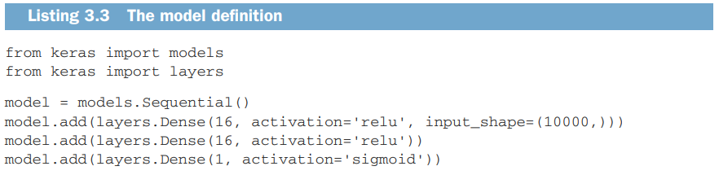

Slide 48
What are activation functions, and why are they necessary?
Without an activation function like relu (also called a non-linearity), the Dense layer would consist of two linear operations—a dot product and an addition
So the layer could only learn linear transformations (affine transformations) of the input data: the hypothesis space of the layer would be the set of all possible linear transformations of the input data into a 16-dimensional space.

Slide 49
Such a hypothesis space is too restricted and wouldn’t benefit from multiple layers of representations, because a deep stack of linear layers would still implement a linear operation: adding more layers wouldn’t extend the hypothesis space.
In order to get access to a much richer hypothesis space that would benefit from deep representations, you need a non-linearity, or activation function.
relu is the most popular activation function in deep learning, but there are many other candidates, which all come with similarly strange names: prelu, elu, and so on.

Slide 50
Loss function
Because you’re facing a binary classification problem and the output of your network is a probability it’s best to use the binary_crossentropy loss
It isn’t the only viable choice: you could use, for instance, mean_squared_error.
But crossentropy is usually the best choice when you’re dealing with models that output probabilities.
Crossentropy is a quantity from the field of Information Theory that measures the distance between probability distributions or, in this case, between the ground-truth distribution and your predictions.

Slide 51
model.compile(optimizer='rmsprop', loss='binary_crossentropy', metrics=['accuracy'])
You’re passing your optimizer, loss function, and metrics as strings, which is possible because rmsprop, binary_crossentropy, and accuracy are packaged as part of Keras.

Slide 52
Sometimes you may want to configure the parameters of your optimizer or pass a custom loss function or metric function.
The former can be done by passing an optimizer class instance as the optimizer argument, as shown in listing 3.5; the latter can be done by passing function objects as the loss and/or metrics arguments, as shown in listing 3.6.

Slide 53
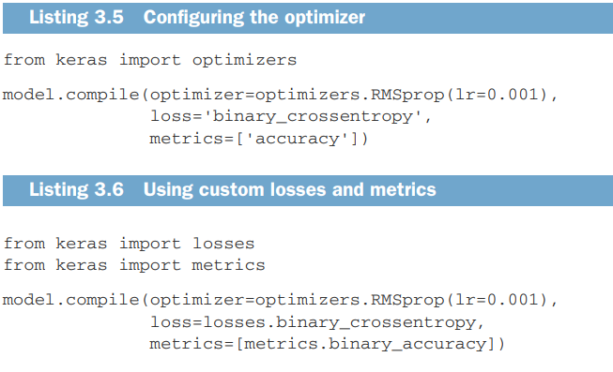

Slide 54
x_val = x_train[:10000]
partial_x_train = x_train[10000:]
y_val = y_train[:10000] partial_y_train = y_train[10000:]

Slide 55
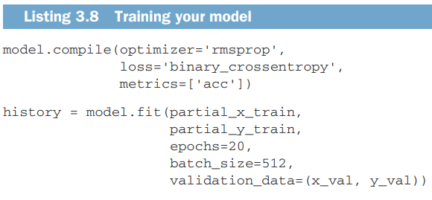

Slide 56
Note that the call to model.fit() returns a History object.
This object has a member history, which is a dictionary containing data about everything that happened during training
>>> history_dict = history.history
>>> history_dict.keys()
[u'acc', u'loss', u'val_acc', u'val_loss']

Slide 57
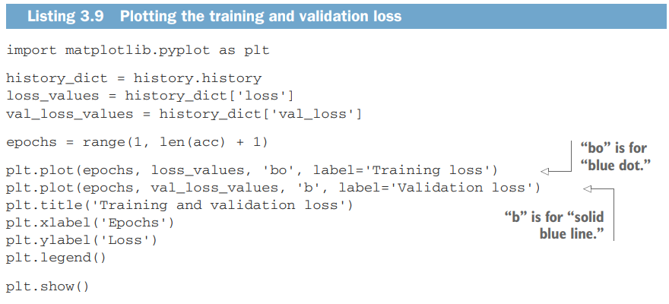

Slide 58
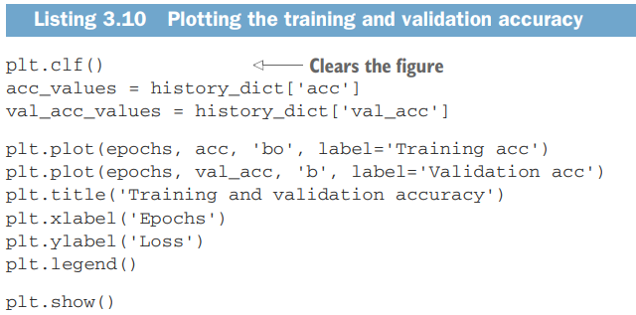

Slide 59
Overfitting
As you can see, the training loss decreases with every epoch, and the training accuracy increases with every epoch.
That’s what you would expect when running gradientdescent optimization—the quantity you’re trying to minimize should be less with every iteration. But that isn’t the case for the validation loss and accuracy: they seem to peak at the fourth epoch.

Slide 60
This is an example of what we warned against earlier: a model that performs better on the training data isn’t necessarily a model that will do better on data it has never seen before.
In precise terms, what you’re seeing is overfitting: after the second epoch, you’re overoptimizing on the training data, and you end up learning representations that are specific to the training data and don’t generalize to data outside of the training set

Slide 61
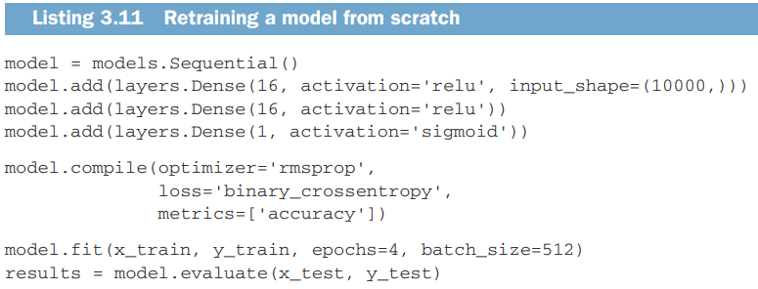

Slide 62
Using a trained network to generate predictions on new data
model.predict(x_test)
Try the following choices:
You used two hidden layers. Try using one or three hidden layers, and see how doing so affects validation and test accuracy.
Try using layers with more hidden units or fewer hidden units: 32 units, 64 units, and so on.
Try using the mse loss function instead of binary_crossentropy.
Try using the tanh activation (an activation that was popular in the early days of neural networks) instead of relu

Slide 63
Wrapping up
You usually need to do quite a bit of preprocessing on your raw data in order to be able to feed it—as tensors—into a neural network. Sequences of words can be encoded as binary vectors, but there are other encoding options, too.
Stacks of Dense layers with relu activations can solve a wide range of problems
In a binary classification problem (two output classes), your network should end with a Dense layer with one unit and a sigmoid activation: the output of your network should be a scalar between 0 and 1, encoding a probability

Slide 64
With such a scalar sigmoid output on a binary classification problem, the loss function you should use is binary_crossentropy.
The rmsprop optimizer is generally a good enough choice, whatever your problem. That’s one less thing for you to worry about.
As they get better on their training data, neural networks eventually start overfitting and end up obtaining increasingly worse results on data they’ve never seen before. Be sure to always monitor performance on data that is outside of the training set.

Slide 65
Classifying newswires: a multiclass classification example
In this section, you’ll build a network to classify Reuters newswires into 46 mutually exclusive topics.
Because you have many classes, this problem is an instance of multiclass classification; and because each data point should be classified into only one category, the problem is more specifically an instance of single-label, multiclass classification.
If each data point could belong to multiple categories (in this case, topics), you’d be facing a multilabel, multiclass classification problem.

Slide 66
Reuters data set
You’ll work with the Reuters dataset, a set of short newswires and their topics, published by Reuters in 1986.
It’s a simple, widely used toy dataset for text classification.
There are 46 different topics; some topics are more represented than others, but each topic has at least 10 examples in the training set.

Slide 67
Loading the Reuters dataset
from keras.datasets import reuters
(train_data, train_labels), (test_data, test_labels) = reuters.load_data( num_words=10000)
len(train_data)
len(test_data)
train_data[10]

Slide 68
word_index = reuters.get_word_index()
reverse_word_index = dict([(value, key) for (key, value) in word_index.items()])
decoded_newswire = ' '.join([reverse_word_index.get(i - 3, '?') for i in train_data[0]])

Slide 69
Encoding the data
import numpy as np
def vectorize_sequences(sequences, dimension=10000):
results = np.zeros((len(sequences), dimension))
for i, sequence in enumerate(sequences):
results[i, sequence] = 1.
return results
x_train = vectorize_sequences(train_data)
x_test = vectorize_sequences(test_data)

Slide 70
Encoding the labels
To vectorize the labels, there are two possibilities: you can cast the label list as an integer tensor, or you can use one-hot encoding.
One-hot encoding is a widely used format for categorical data, also called categorical encoding

Slide 71
def to_one_hot(labels, dimension=46):
results = np.zeros((len(labels), dimension))
for i, label in enumerate(labels):
results[i, label] = 1.
return results
one_hot_train_labels = to_one_hot(train_labels)
one_hot_test_labels = to_one_hot(test_labels)

Slide 72
Using keras to encode labels
from keras.utils.np_utils import to_categorical
one_hot_train_labels = to_categorical(train_labels)
one_hot_test_labels = to_categorical(test_labels)

Slide 73
Building your network
This topic-classification problem looks similar to the previous movie-review classification problem: in both cases, you’re trying to classify short snippets of text.
But there is a new constraint here: the number of output classes has gone from 2 to 46.

Slide 74
Defining model
from keras import models
from keras import layers model = models.Sequential()
model.add(layers.Dense(64, activation='relu', input_shape=(10000,)))
model.add(layers.Dense(64, activation='relu'))
model.add(layers.Dense(46, activation='softmax'))

Slide 75
You end the network with a Dense layer of size 46
The last layer uses a softmax activation. It means the network will output a probability distribution over the 46 different output classes

Slide 76
Loss function
The best loss function to use in this case is categorical_crossentropy
It measures the distance between two probability distributions: here, between the probability distribution output by the network and the true distribution of the labels.
By minimizing the distance between these two distributions, you train the network to output something as close as possible to the true labels.

Slide 77
model.compile(optimizer='rmsprop', loss='categorical_crossentropy', metrics=['accuracy'])

Slide 78
Validating your approach
x_val = x_train[:1000]
partial_x_train = x_train[1000:]
y_val = one_hot_train_labels[:1000]
partial_y_train = one_hot_train_labels[1000:]

Slide 79
history = model.fit(partial_x_train, partial_y_train, epochs=20, batch_size=512, validation_data=(x_val, y_val))

Slide 80
Plotting the training and validation loss
import matplotlib.pyplot as plt
loss = history.history['loss']
val_loss = history.history['val_loss']
epochs = range(1, len(loss) + 1)
plt.plot(epochs, loss, 'bo', label='Training loss')
plt.plot(epochs, val_loss, 'b', label='Validation loss')
plt.title('Training and validation loss')
plt.xlabel('Epochs')
plt.ylabel('Loss')
plt.legend()
plt.show()

Slide 81
Plotting the training and validation accuracy
plt.clf()
acc = history.history['acc']
val_acc = history.history['val_acc']
plt.plot(epochs, acc, 'bo', label='Training acc')
plt.plot(epochs, val_acc, 'b', label='Validation acc')
plt.title('Training and validation accuracy')
plt.xlabel('Epochs')
plt.ylabel('Loss')
plt.legend()
plt.show()

Slide 82
Generating predictions on new data
predictions = model.predict(x_test)

Slide 83
A different way to handle the labels and the loss
y_train = np.array(train_labels)
y_test = np.array(test_labels)
model.compile(optimizer='rmsprop', loss='sparse_categorical_crossentropy', metrics=['acc'])

Slide 84
Predicting house prices: a regression example
Another common type of machine-learning problem is regression, which consists of predicting a continuous value instead of a discrete label: for instance, predicting the temperature tomorrow, given meteorological data; or predicting the time that a software project will take to complete, given its specifications.

Slide 85
The Boston Housing Price dataset
You’ll attempt to predict the median price of homes in a given Boston suburb in the mid-1970s, given data points about the suburb at the time, such as the crime rate, the local property tax rate, and so on
It has relatively few data points: only 506, split between 404 training samples and 102 test samples. And each feature in the input data (for example, the crime rate) has a different scale.
For instance, some values are proportions, which take values between 0 and 1; others take values between 1 and 12, others between 0 and 100, and so on

Slide 86
Loading the dataset
from keras.datasets import boston_housing
(train_data, train_targets), (test_data, test_targets) = boston_housing.load_data()

Slide 87
Normalizing the dataset
mean = train_data.mean(axis=0)
train_data -= mean
std = train_data.std(axis=0)
train_data /= std
test_data -= mean test_data /= std

Slide 88
Building the model
from keras import models
from keras import layers
def build_model():
model = models.Sequential()
model.add(layers.Dense(64, activation='relu', input_shape=(train_data.shape[1],)))
model.add(layers.Dense(64, activation='relu'))
model.add(layers.Dense(1))
model.compile(optimizer='rmsprop', loss='mse', metrics=['mae']) return model

Slide 89
The network ends with a single unit and no activation (it will be a linear layer).
This is a typical setup for scalar regression

Slide 90
Validating your approach using K-fold validation
import numpy as np
k=4
num_val_samples = len(train_data) // k
num_epochs = 100 all_scores = []

Slide 91
for i in range(k):
print('processing fold #', i)
val_data = train_data[i * num_val_samples: (i + 1) * num_val_samples]
val_targets = train_targets[i * num_val_samples: (i + 1) * num_val_samples]
partial_train_data = np.concatenate( [train_data[:i * num_val_samples], train_data[(i + 1) * num_val_samples:]], axis=0)
partial_train_targets = np.concatenate( [train_targets[:i * num_val_samples], train_targets[(i + 1) * num_val_samples:]], axis=0)

Slide 92
model = build_model()
model.fit(partial_train_data, partial_train_targets, epochs=num_epochs, batch_size=1, verbose=0)
val_mse, val_mae = model.evaluate(val_data, val_targets, verbose=0)
all_scores.append(val_mae)

Slide 93
Once you’re finished tuning other parameters of the model you can train a final production model on all of the training data, with the best parameters, and then look at its performance on the test data.

Slide 94
model = build_model()
model.fit(train_data, train_targets, epochs=80, batch_size=16, verbose=0)
test_mse_score, test_mae_score = model.evaluate(test_data, test_targets)

